Slide 1
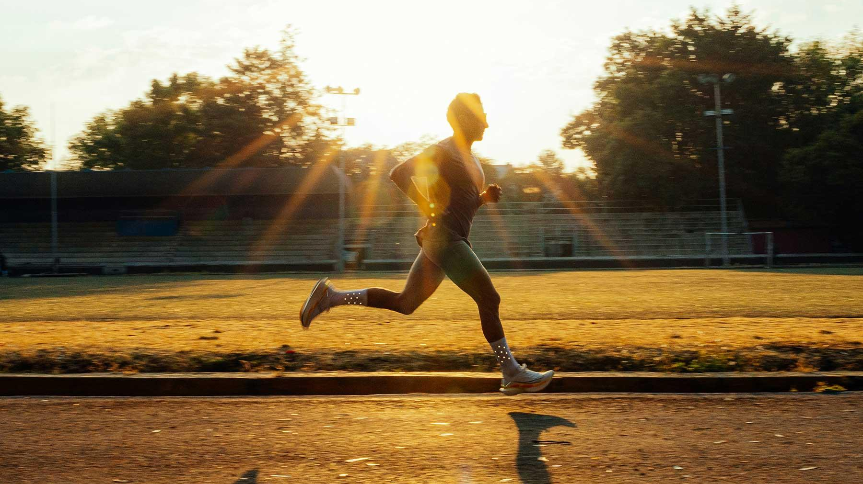
Running Efficiency

Slide 2
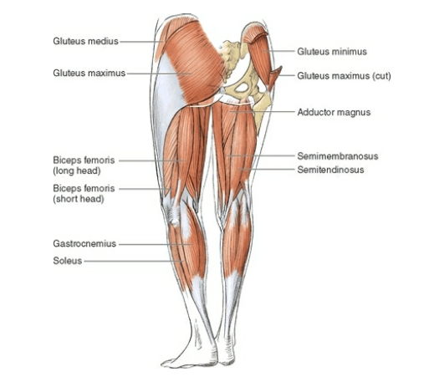
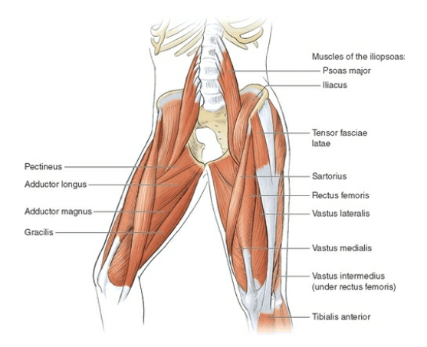
Basic Anatomy
Anterior View
Posterior view
Notes:
"Most people think that running is all about the legs, but it's actually a full-body movement. Every running stride requires muscles from the feet all the way up to the shoulders to work together.
Muscles have three main jobs when it comes to running:
produce forward movement,
absorb the impact when we land,
and keep the body stable.
Today I'll briefly explain these three roles before showing how these muscles work together as one connected system."

Slide 3
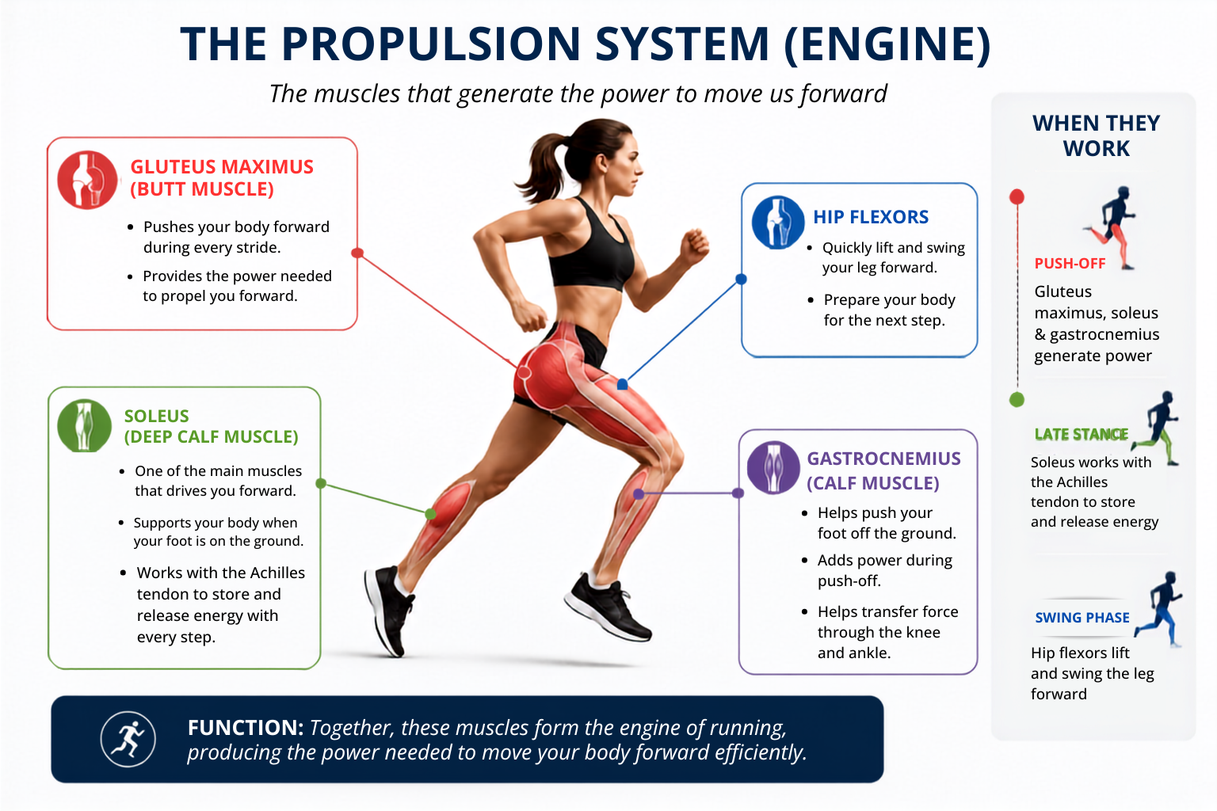
Notes:
"First, we have what I like to call the engine of running.
The propulsion system is essentially the engine of running. These muscles work together to generate the power needed to move us forward.
The gluteus maximus is the primary power muscle, producing strong hip extension during push-off to propel the body forward. The soleus is actually one of the biggest contributors to forward propulsion, while the gastrocnemius assists with push-off and force transfer through the ankle.
Working with these muscles, the Achilles tendon stores and releases elastic energy like a spring, making every stride more economical. Finally, the hip flexors rapidly swing the leg forward during the swing phase, preparing the body for the next step.
Together, these muscles work in sequence to create an efficient and powerful running stride

Slide 4
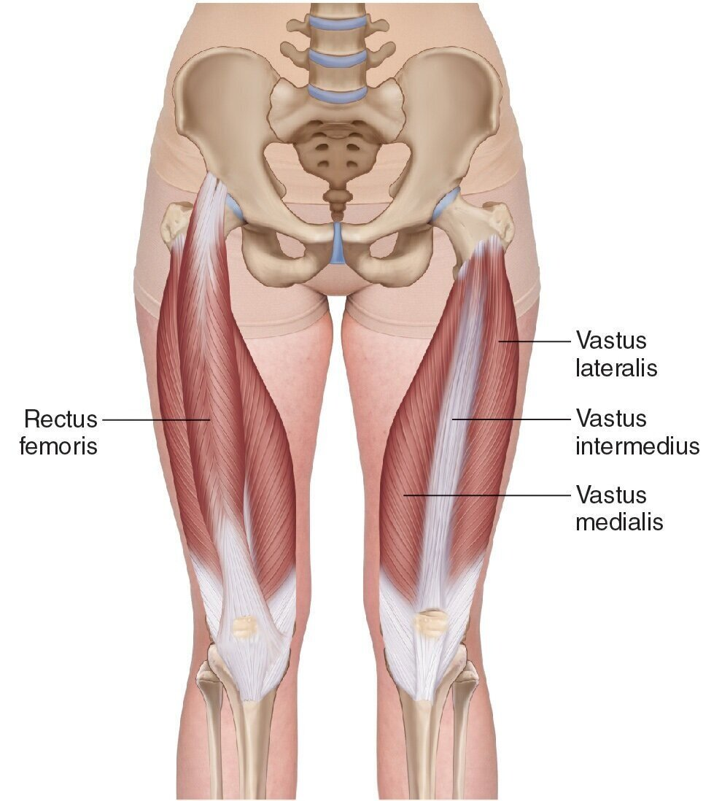
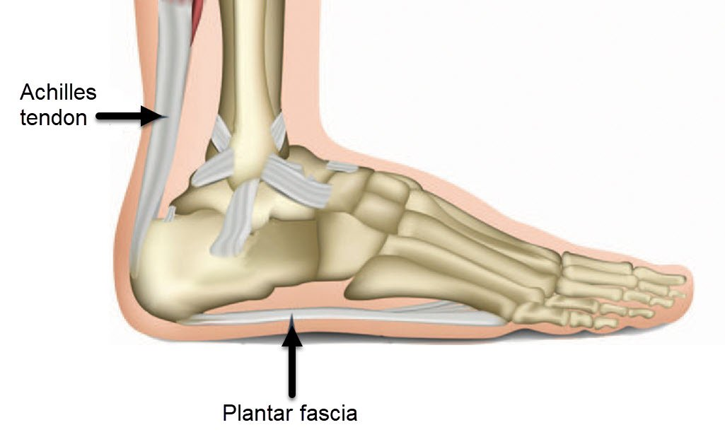
The Shock Absorbers
Quads
Notes:
Every time we land while running, the body experiences forces that can be two to three times our body weight.
The quadriceps act like brakes by controlling knee bending during landing, helping absorb these forces.
The foot and ankle muscles constantly adapt to the ground beneath us, spreading the load across the foot.
The Achilles tendon is particularly interesting because it doesn't simply absorb force, it stores elastic energy during landing and returns that energy during push-off. This improves running efficiency and reduces the amount of energy our muscles need to produce

Slide 5
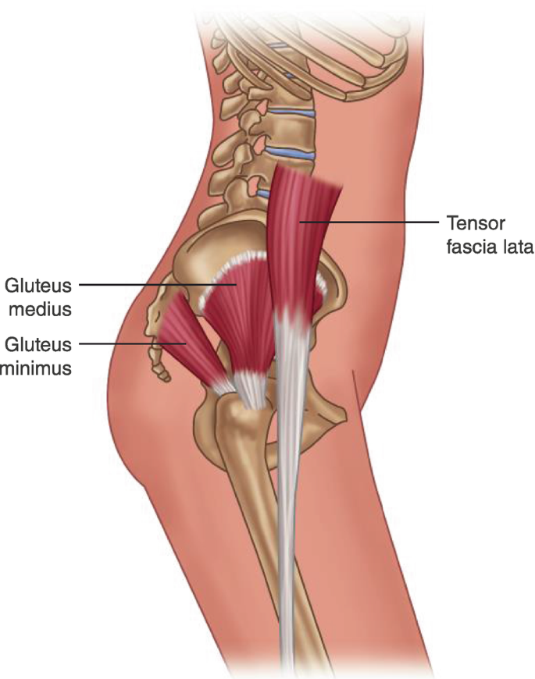
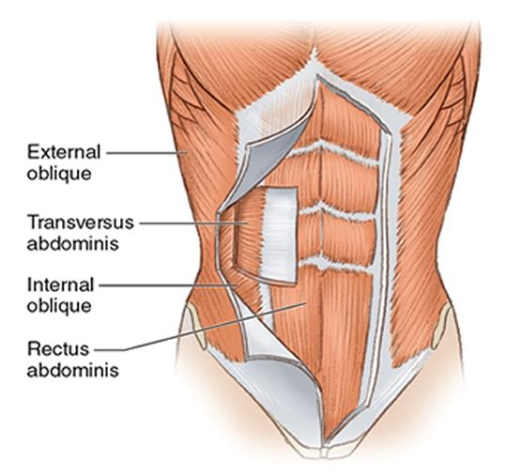
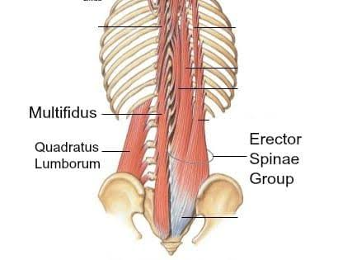
The Pelvic and Core Stabilizers
Lateral
Anterior
Posterior
Notes:
Generating power is only useful if the body is stable enough to transfer it efficiently.
The gluteus medius, gluteus minimus and tensor fascia lata stabilize the pelvis every time we're standing on one leg which actually happens with every running stride.
The deep core muscles stabilize the trunk and pelvis, reducing unnecessary movement and allowing force to transfer efficiently between the upper and lower body.
Without good stability, energy leaks occur, making running less efficient and increasing injury risk.

Slide 6
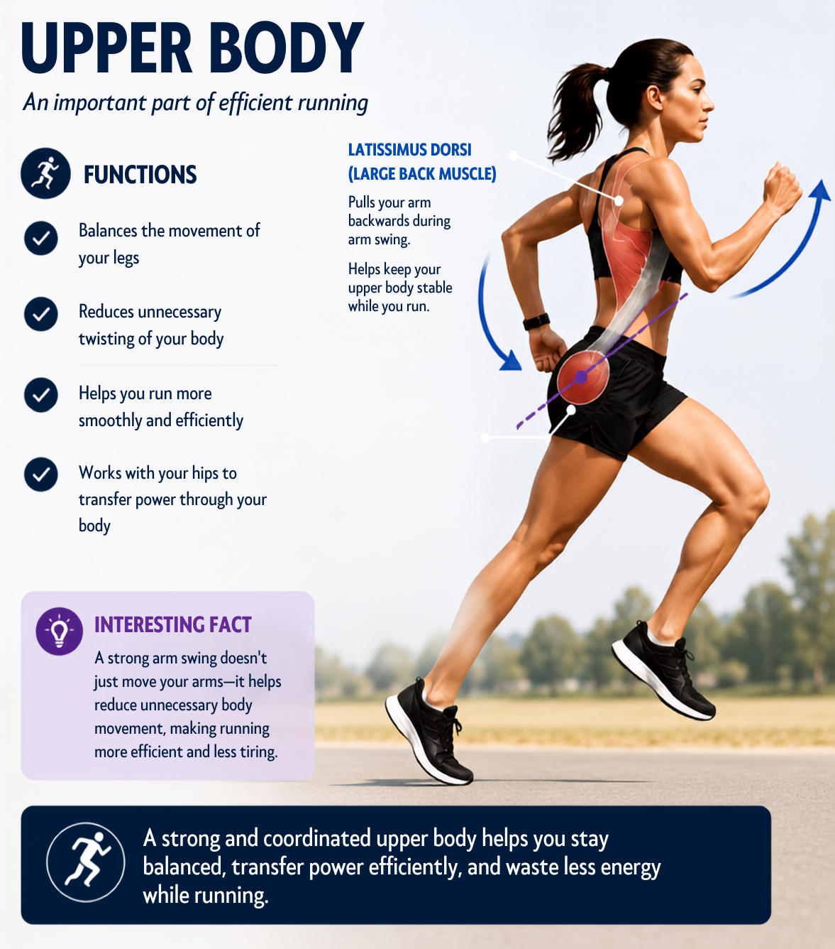
Notes:
Many people think running is all about the legs, but the upper body plays a major role in making running efficient.
The main job of the upper body is to maintain balance and stability. As one leg moves forward, the opposite arm swings forward. This counter movement helps reduce unnecessary rotation of the trunk and keeps the body moving in a straight line.
One of the key muscles involved is the latissimus dorsi, or the large back muscle. It pulls the arm backwards during arm swing and helps stabilize the upper body.
A strong and coordinated arm swing doesn't just move the arms it improves balance, reduces unnecessary movement, conserves energy, and ultimately makes running more efficient."

Slide 7
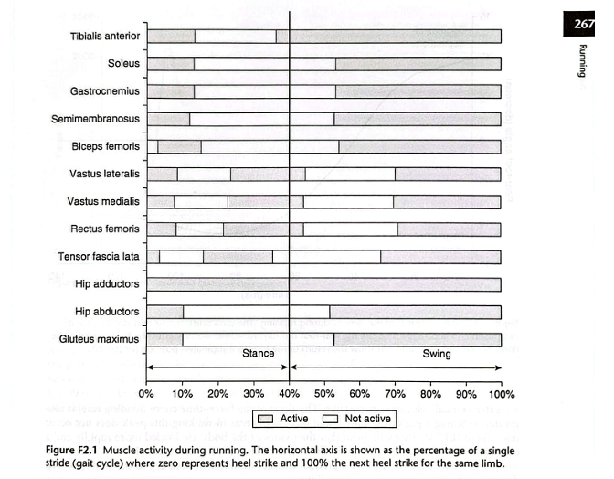
Notes:
Although we've discussed individual muscles, they don't work in isolation. This graph shows that different muscles switch on and off throughout the running cycle, depending on the demands of each phase.
This coordinated activation allows the body to absorb impact, maintain stability, and generate propulsion efficiently.
These muscles are linked through fascia to form myofascial slings, which transfer force between the upper and lower body, much like the body's transmission system.

Slide 8
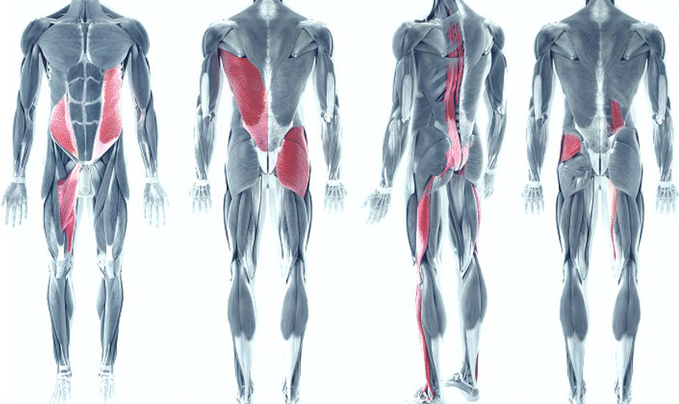
4 Major Slings
Anterior Oblique Sling
Posterior Oblique sling
Deep Longitudinal Sling
Lateral Sling
Notes:
There are four major muscle slings that work together to improve running efficiency.
The Posterior Oblique Sling connects the gluteus maximus to the opposite latissimus dorsi through the thoracolumbar fascia. It generates propulsion, controls trunk rotation, and coordinates arm and leg movement during push-off. Think of it as the right glute working with the left lat.
The Anterior Oblique Sling, made up of the obliques and adductors, stabilizes the pelvis while allowing trunk rotation and forward leg swing. It becomes especially important during acceleration and changes in direction.
Transfers force through the body
Stores and releases energy with every stride
This sling helps make running more efficient by recycling energy during each step.
The Lateral Sling includes the gluteus medius, gluteus minimus, TFL, IT band, and opposite quadratus lumborum. Its primary role is to keep the pelvis level during the single-leg stance phase. Since every running stride involves a period where one leg supports the entire body, this sling is essential for maintaining pelvic stability and preventing excessive side-to-side movement.
Finally, the Deep Longitudinal Sling connects the posterior chain from the spine to the lower leg. It helps absorb impact, transfer ground reaction forces, and store and release elastic energy, making every stride more efficient."

Slide 9
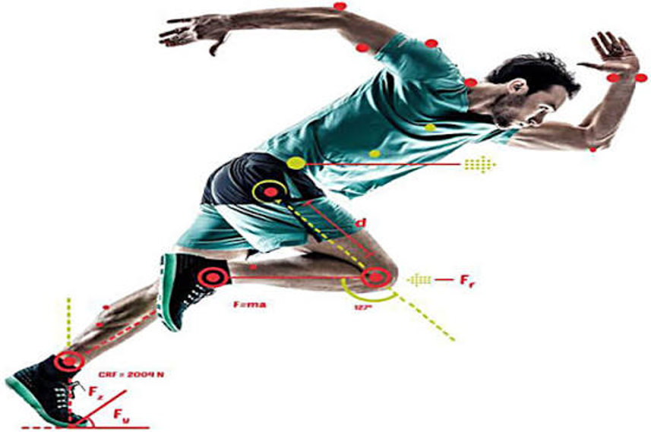
Running Biomechanics
Cyclic movement pattern
Gait comprises of a swing phase and stance phase
Differentiated from walking by flight phase between phases of single support rather than a double support phase
60% of cycle is swing phase
40% of cycle is stance phase

Slide 10
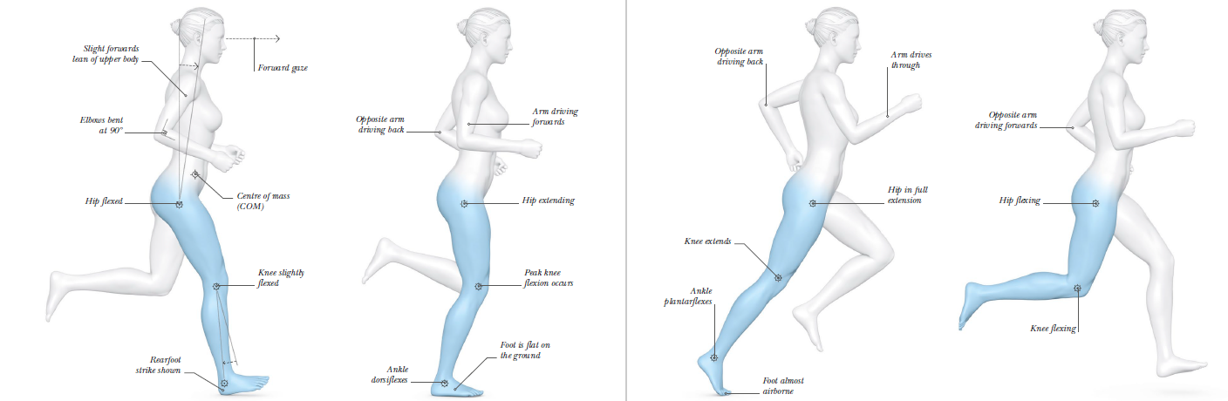
GAIT ANALYSIS
Initial Contact
Midstance
Toe-Off
Swing

Slide 11
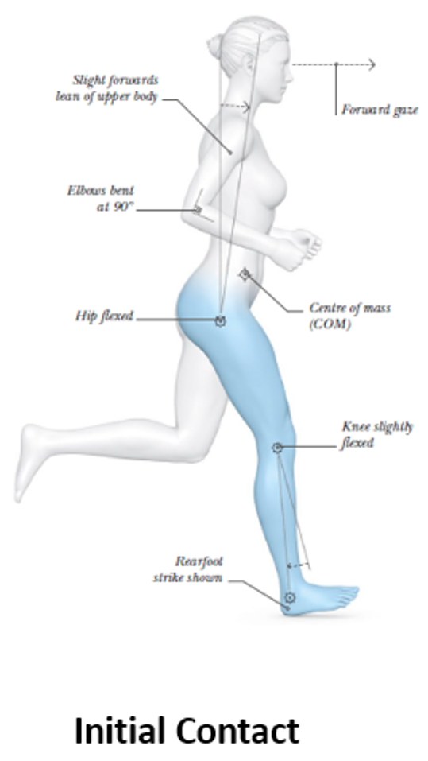
The foot makes initial contact with the ground, with the body vertical as it decelerates
Substantial muscle contributions are needed to control the ground reaction force (GRF)

Slide 12
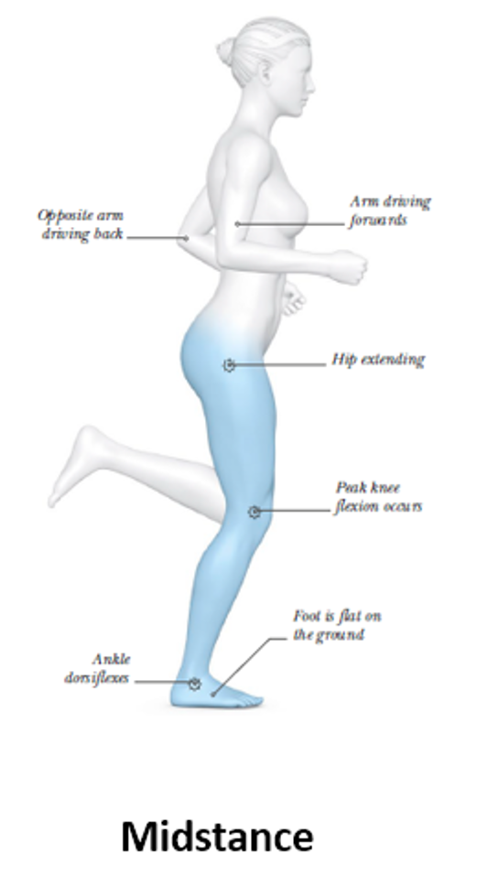
The body now transitions from absorbing GRF to releasing recycled GRF energy for propulsion
As the body passes over the top of the supporting leg, it must be dynamically stabilized to cope with maximal loading through the limb

Slide 13
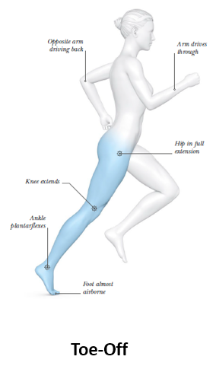
The hip, knee and ankle are in maximal extension to propel the body forwards
Immediately after toe-off, the hip and knee begin to move into flexion and the ankle starts to dorsiflex, preparing for the swing phase

Slide 14
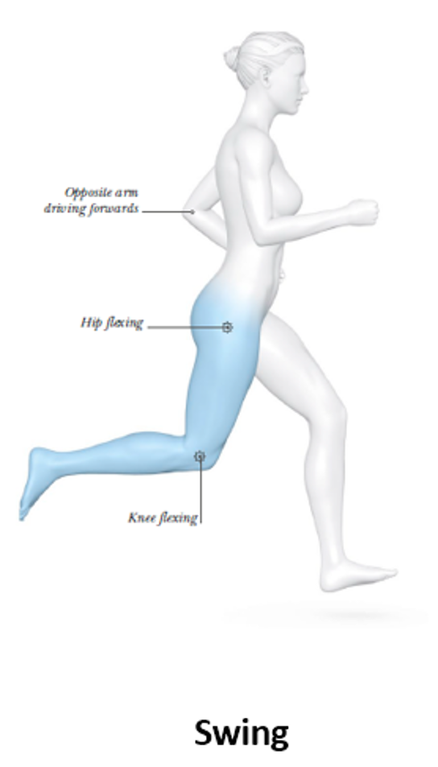
Comprises approximately 60 per cent of the running cycle
This is when the hip flexes rapidly to swing the leg through until it recovers to its starting position, and ready to power another step
During late swing, the knee begins to extend and prepare again for stance position.

Slide 15
Running Speed
Increased through increasing stride length and/or stride frequency
Typically stride length is increased first up to approximately 7 m/s then stride frequency increases
This is related to energy cost of running
There is a stronger relationship between stride length and factors such as strength and flexibility compared to the relationship between side length and anthropometric measures
Notes:
Optimum frequency where energy cost is minimised and if frequency is increased, energy cost per unit distance covered is increased making the runner less efficient.

Slide 16
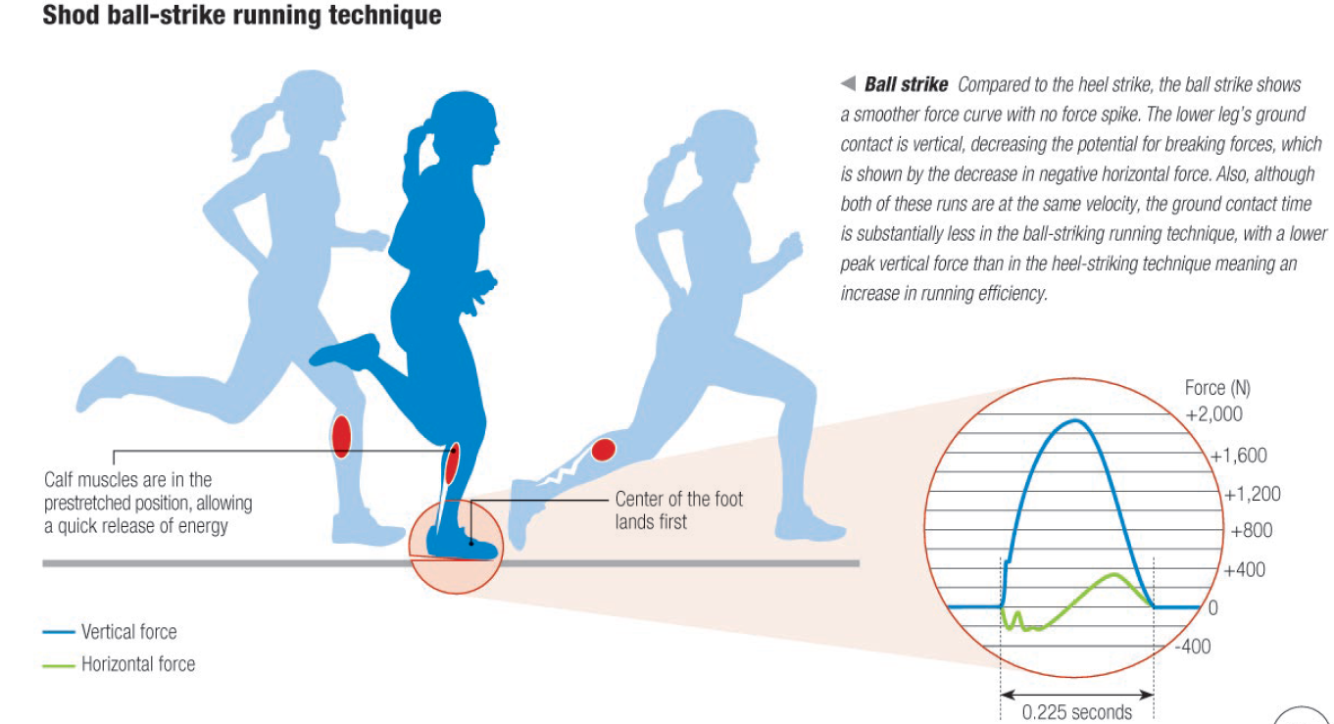
Forefoot Strike (FFS) vs Rearfoot Strike (RFS)

Slide 17
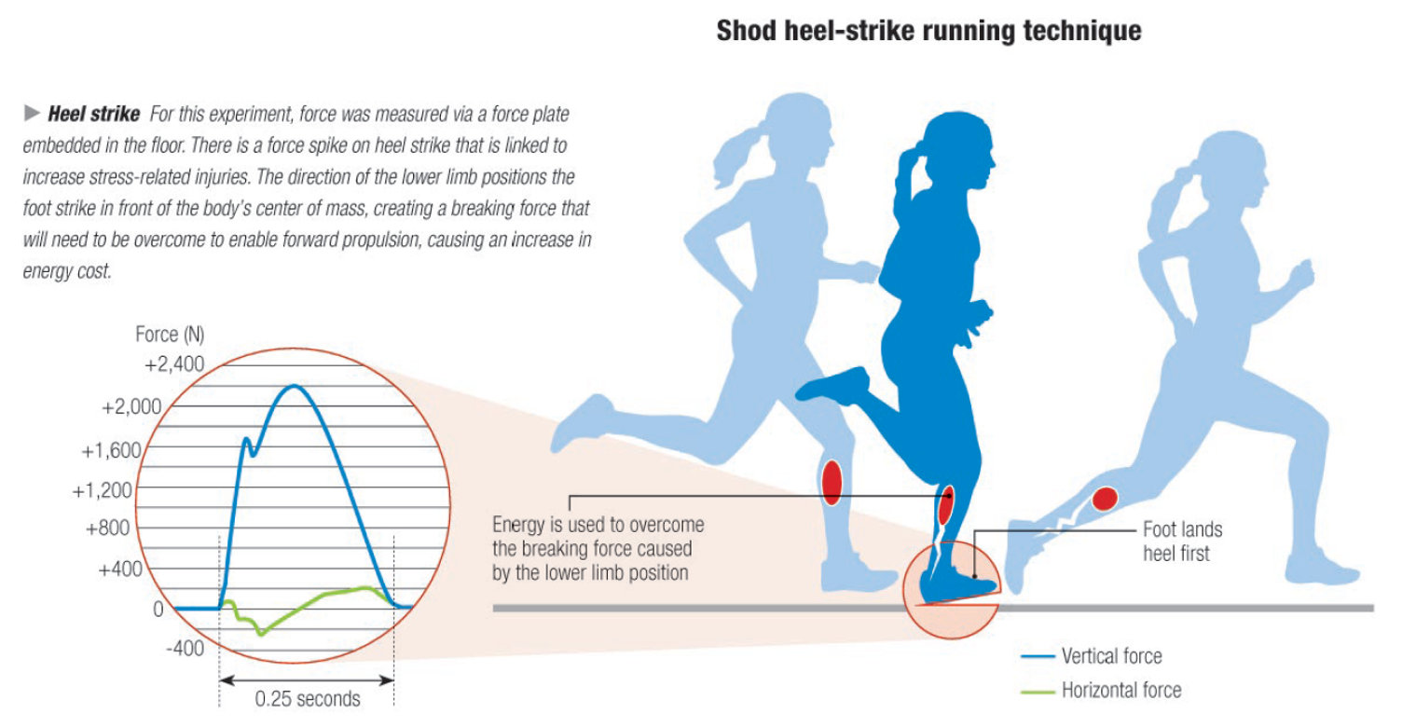
Forefoot Strike (FFS) vs Rearfoot Strike (RFS)

Slide 18
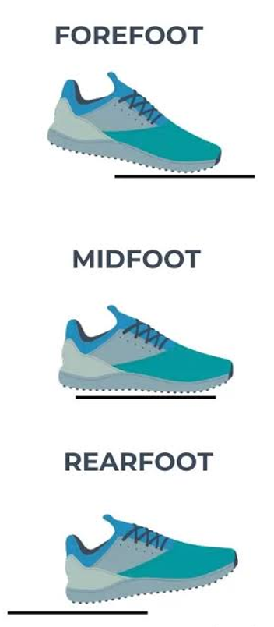
Forefoot Strike (FFS) vs Rearfoot Strike (RFS)
FFS pattern is associated with greater loads on the foot and ankle
RFS pattern is associated with greater demands on the knee
Majority of the differences between RFS and FFS therefore occur in the early part of the stance phase, and are directly related to the way the foot contacts the ground
FFS running is associated with lower vertical load rates compared to RFS
RFS runners in a recent study displayed increased repetitive stress injuries twice as frequently as FFS runners

Slide 19
Barefoot Running
Humans have been running since the beginning of time
Relatively slow runners compared to other scavengers, but humans evolved into effective endurance runners
Strike patterns during barefoot running likely represent our most natural form, as cushioned running shoes have only existed for the past 50 years
Although there is strong evidence to show that run strike patterns in our most natural state can be mimicked in footwear that does not interfere with our natural mechanics, which ultimately reduces injury risk in runners
Interesting study in India showed that children who live in communities where they are habitually barefoot have significantly higher arches than others from communities where either open toed sandals or closed toe shoes are worn
Still up to 79% of modern endurance runners are injured annually

Slide 20
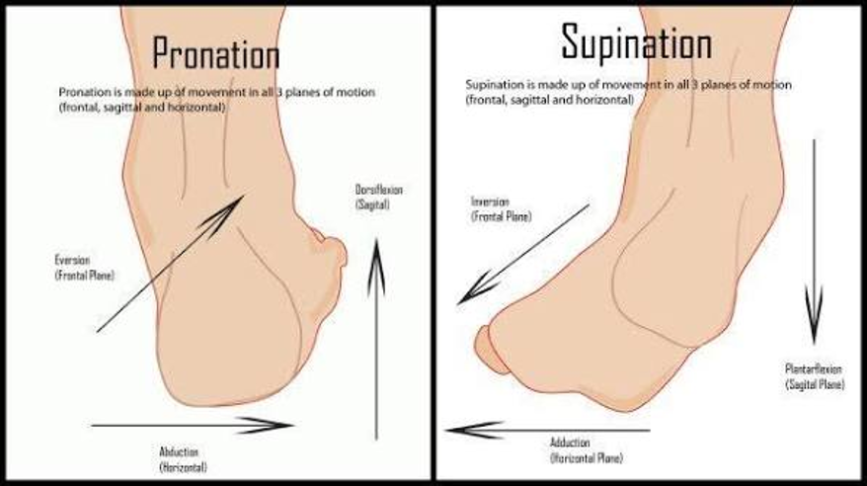
Pronation and Supination
Pronation
  Eversion, dorsiflexion, abduction
  (turned out and up)
Supination
  Inversion, plantarflexion, adduction
  (turned in and down)
Overpronation
  Foot arch flattened excessively

Slide 21
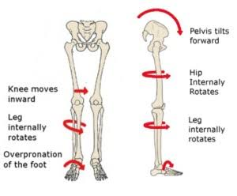
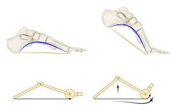
Why is this important?
Windlass Mechanism
Knee Joint Loading
Toe dorsiflexes causing the plantar fascia to tighten creating the rigid structure need for push off
Excessive pronation leads to tibial internal rotation misaligning the knee joint and causing pian in the knee

Slide 22
Important Considerations
You can’t just change your biomechanics
Ground reaction forces equal 2-2.5 times our body weight and can reach up to 3 times body weight at higher speeds
Conditioning is so important to do so the body can cope with the load it needs to carry

Slide 23
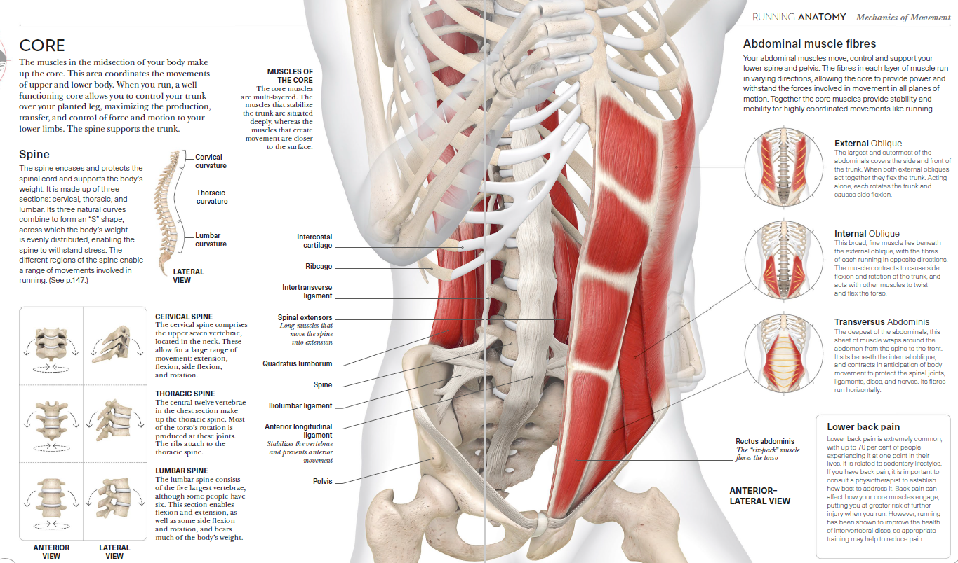
CORE STABILITY

Slide 24
STABILITY – CORE VS TRUNK
A common trend has seen a shift in referring to “The Core” to the preferred term “the Trunk”
There has also been a move away from separating the core into smaller local and larger global muscles for bearing on core stability for dynamic movement in healthy people.
An interesting recent study of Transversus and Multifidus activation in runners showed that right-handed endurance runners activate their core muscles on the right side significantly more than on their left side, with no such anomaly in left dominant runners
This imbalance was more prevalent in endurance runners, despite no current low back pain.
It is therefore recommended that right-handed endurance runners may benefit from neuromuscular retraining or strengthening of the left-sided core muscles even in the absence of low back pain

Slide 25
STABILITY – CORE VS TRUNK
From a proactive stance, the running style of novice right-handed endurance runners should be assessed and given appropriate preventative exercises.
In most studies trunk muscle strength was measured by the timed isometric test (Prone Bridge), which current thinking believes does not reflect force and velocity of movement in dynamic athletic activity
Recent surface electromyography methodology showed there is evidence that loaded exercises performed in a standing position, e.g. Barbell Squats, are an effective method of overloading the trunk stabilization system in a dynamic manner.
Correct movement pattern was still identified as the most important exercise selection criteria for development of core stability for dynamic athletic performance.

Slide 26
Training the “Kinetic Chain”
Running produces loads of up to 2.5-3 times bodyweight, placing tendons under tension for short periods of time - when your foot is in contact with the ground
Heavy resistance training offers an opportunity to increase tendon stiffness under loads greater than those achieved during running, and for longer periods, thereby improving running performance.
Novices with no current injuries commencing run strengthening programmes should ideally choose 3–5 exercises that target the hip, thigh, and calf muscles
A minimum of 2 sessions per week for at least 6 weeks is recommended in order to see strength gains
The number of reps and sets should be performed on each side of the body (alternating sides between sets), ensuring there is enough resistance for muscles to feel fatigued by the end of each set
When at the point of lifting heavier weights, give 2–3 minutes recovery time between sets.

Slide 27
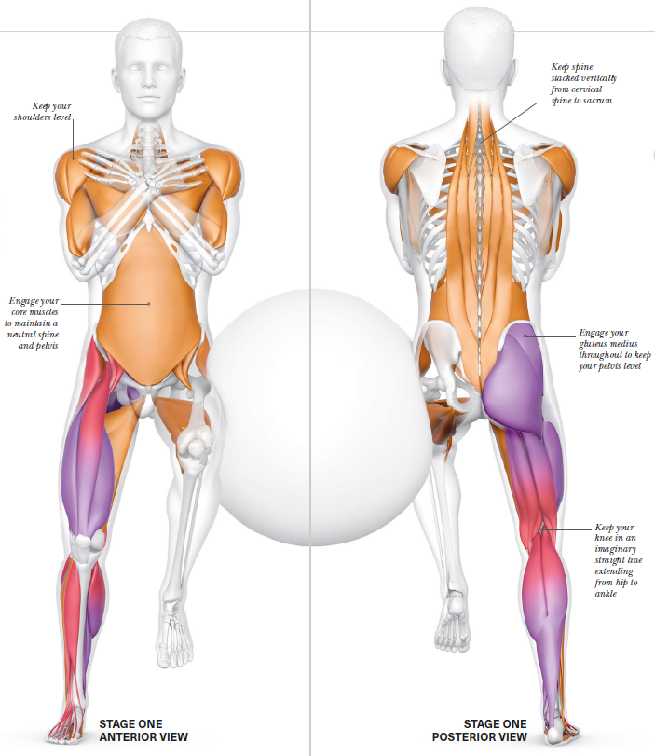
Single Leg Ball Squat

Slide 28
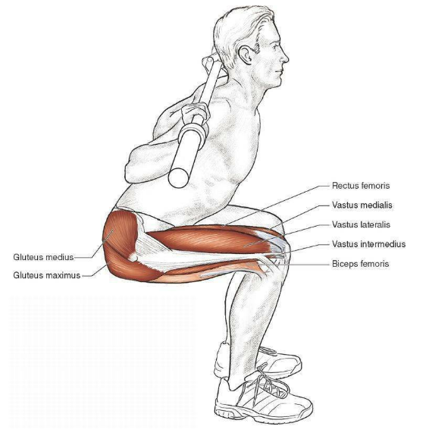
Barbell Deep Back Squat

Slide 29
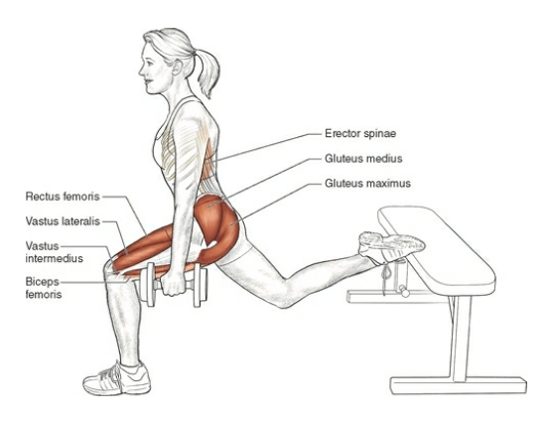
Dumbbell Single Leg Squat

Slide 30
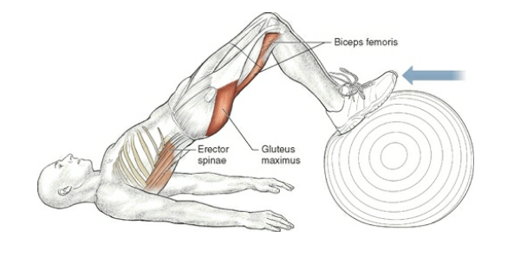
Swiss Ball Hamstring Curl

Slide 31
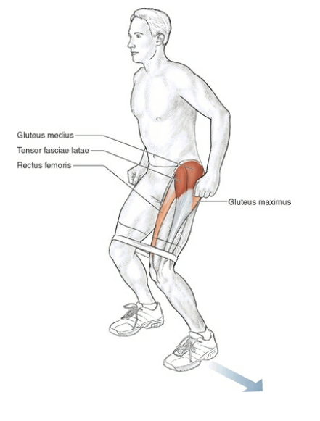
Band Lateral Shuffle “Crab Walks”

Slide 32
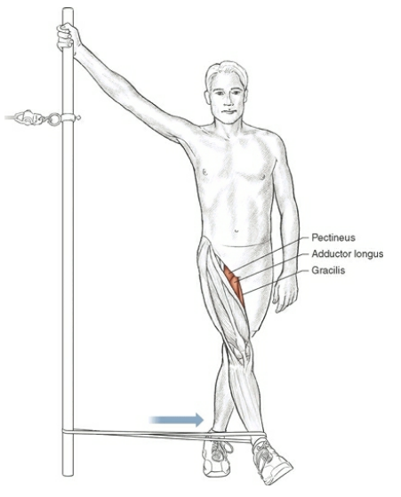
Band/Cable Standing Hip Adduction

Slide 33
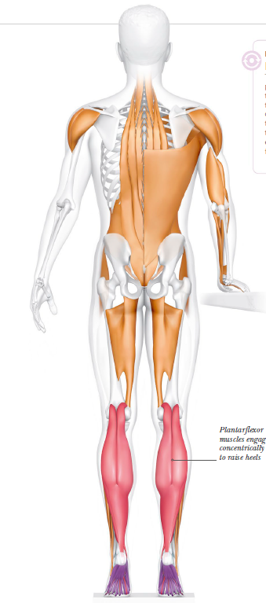
Weighted Eccentric Calf Raises

Slide 34
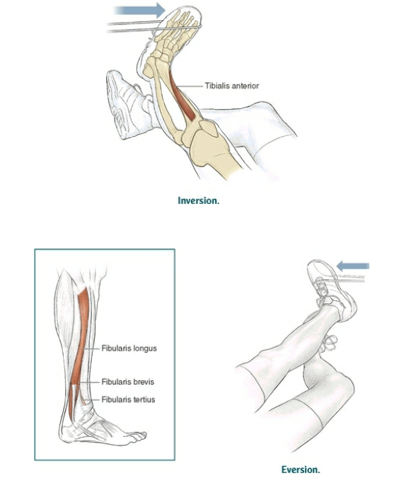
Band Eversion and Inversion Ankle Strengthening

Slide 35
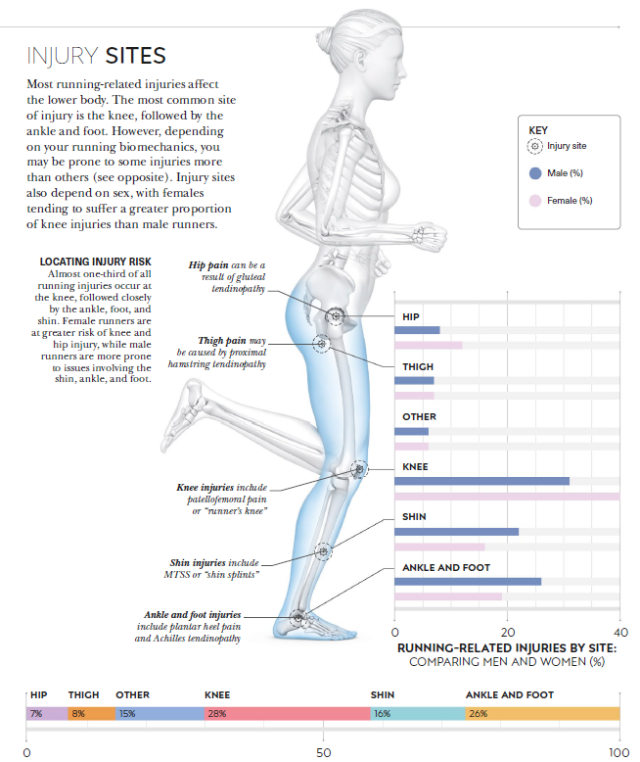
INJURIES

Slide 36
Post –injury Rehabilitation Principles
Phase 1: Restore baseline function | Phase 2: Rebuild strength and capacity | Phase 3: Return to running | Phase 4: Comrades-specific conditioning
Pain and swelling control Range of motion Gait normalization Quadriceps activation | Progressive lower-limb strengthening Hip, gluteal and calf capacity Balance and neuromuscular control Gradual loading of the lateral compartment | Walk-run progression Monitoring next-day response Gradual increase in duration before intensity Avoiding rapid load spikes | Long-run progression Hill tolerance Fatigue resistance Recovery discipline
Reference: Dr Carl Tabane – Sports & Exercise Medicine, July 2026

Slide 37
Comrades Marathon 2027
Recommended mileage by medal
Finish Time | Medal | Kilometres (Weekly Averge) | Kilometres (Total)
 | Gold | >145 | >3200
Sub 7:30 | Silver | 91 | 2000
Sub 9:00 | Bill Rowan | 72-82 | 1600-1800
Sub 10:00 | Robert Mtshali | 55-64 | 1200-1400
Sub 11:00 | Bronze | 43-50 | 950-1100
Sub 12:00 | Vic Clapham | 39-45 | 850-1000
Reference: Dr Carl Tabane – Sports & Exercise Medicine, July 2026

Slide 38

In conclusion, we are now aware that it is not always as easy as putting on our favourite running shoes and going for a run.
Hours are spent teaching cyclists the correct technique with their pedal stroke, and swim instructors in the pool teaching us how to swim efficiently to reduce workload and improve performance, but nobody is teaching us how to run.
Analysing foot strike on a treadmill is a valuable tool however we should evaluate each runner as a unique individual, assessing their form from bottom to top, and top to bottom to strengthen the kinetic chain for running
info@pamblackbio.co.za
www.pamblackbio.co.za

Slide 39
REFERENCES
Dr. Chris Napier. Science of Running. Analyse your Technique, Prevent Injury, Revolutionise your Training. Penguin Random House. 2020
David Mark, ABC News, Australia; Dr. Aaron Beach, New South Wales Institute of Sport, Australia. Why almost everything you thought about running is wrong. Dec 2019
Mitchell, U.H; Johnson, A.W; Owen, P.J; Rantalainen, T; Belavy, D. Transversus abdominis and multifidus asymmetry in runners measured by MRI: a cross-sectional study. BMJ Open Sport & Exercise Medicine. 2019
Clark, D.R; Lambert, M.I; Hunter, A.M. Contemporary perspectives of core stability training for dynamic athletic performance: a survey of athletes, coaches, sports science and sports medicine practitioners. Sports Medicine. 2018
Davis, I.S; Rice, H.M; Wearing, S.C. Why Forefoot Striking in Minimal Shoes might positively change the course of Running Injuries. Journal of Sport and Health Science, Vol.6. 2017
John Brewer. Running Science. Optimizing Training and Performance. University of Chicago. 2017
James Amis. The Split-Second Effect: The Mechanism of How Equinus Can Damage the Human Foot and Ankle. Department of Orthopaedic Surgery, University of Cincinnati. 2016
Tam, N; Wilson, J.L.A; Noakes, T.D; Tucker, R. Barefoot Running: an evaluation of current hypothesis, future research and clinical applications. UCT. 2013
Christopher McDougall. Born to Run. Profile Books. 2010
Ian McLeod. Swimming Anatomy. Human Kinetics. US. 2010
Dr. John A. Hawley. Handbook of Sports Medicine and Science. Running. Blackwell Science. Australia. 2010

Slide 40
REFERENCES
Novacheck TF. (1998). The Biomechanics of Running. Gait & Posture, 7(1), 77–95.
Hamner SR, Seth A, Delp SL. Muscle contributions to propulsion and support during running. National library of Medicine. 2010
Lieberman, DE; Rachlen, DA; Pontzer H; Bramble, DM; Cutright- Smith E. The human gluteus maximus and its role in running. Journal of Experimental Biology. 2006
Semciw A; Neate R; Pizzari T. Running related gluteus medius function in health and injury: A systematic review with meta-analysis. Journal Electromyography and Kinesiology. 2016
Kelly LA; Farris DJ; Cresswell AG; Lichtwark GA; Intrinsic foot muscles contribute to elastic energy storage and return in the human foot. J Appl Physiol. 2018
Koo, YJ; Ogihara, N; & Koo, S; Active Arm Swing During Running Improves Rotational Stability of the Upper Body and Metabolic Energy Efficiency. Ann Biomed Eng. 2025
Lee, J. Anatomical slings: Enhancing movement and stability. ME Physio.2021

Slide 41
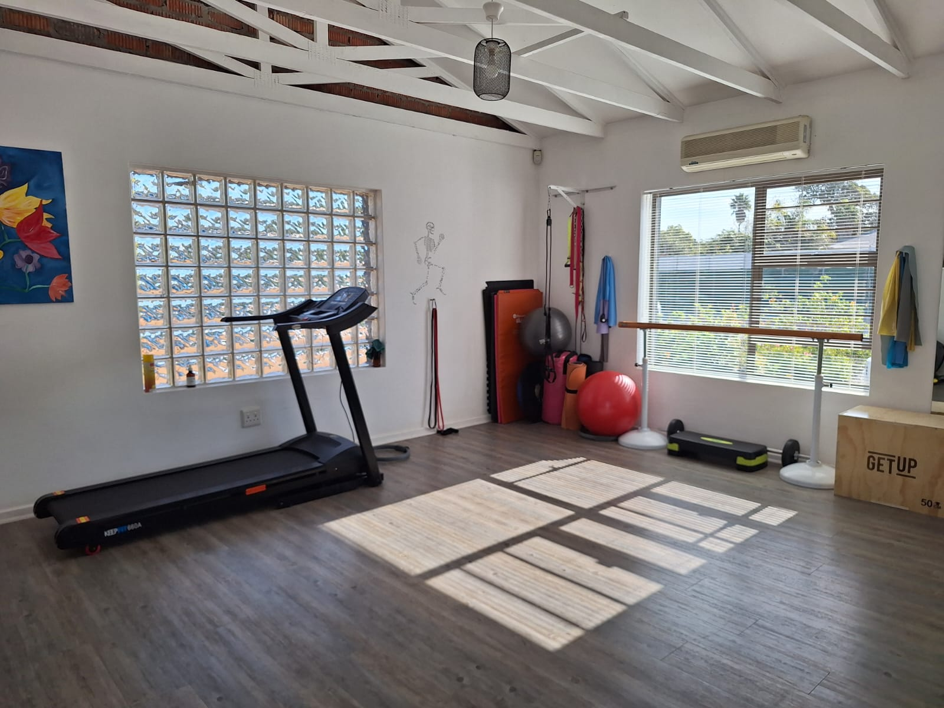
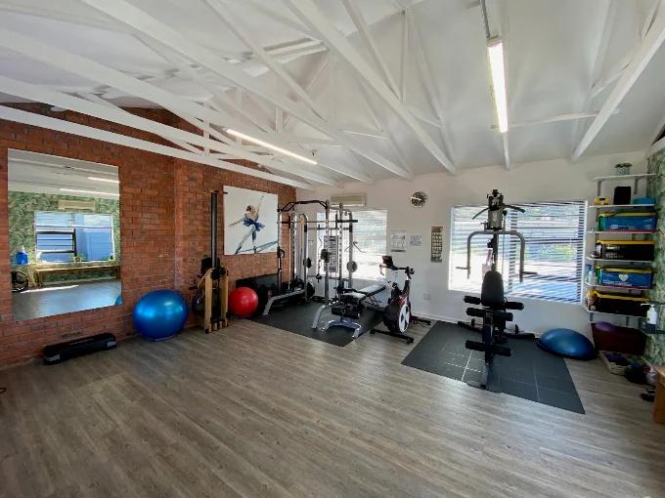
Questions?

